Slide 1
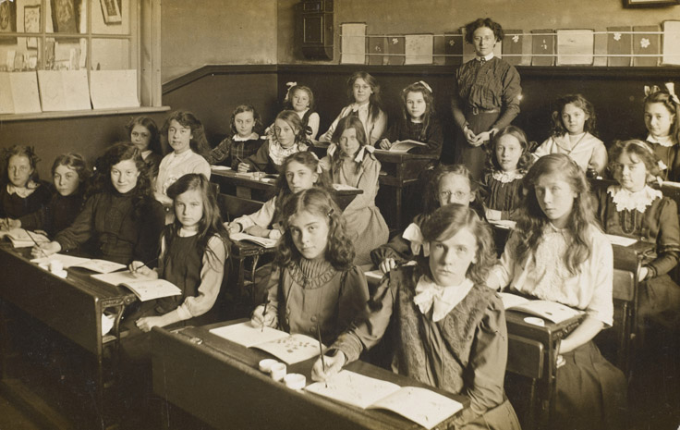
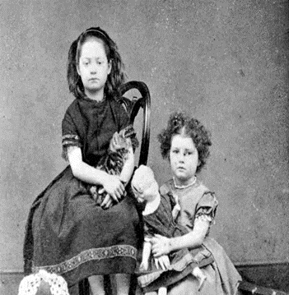
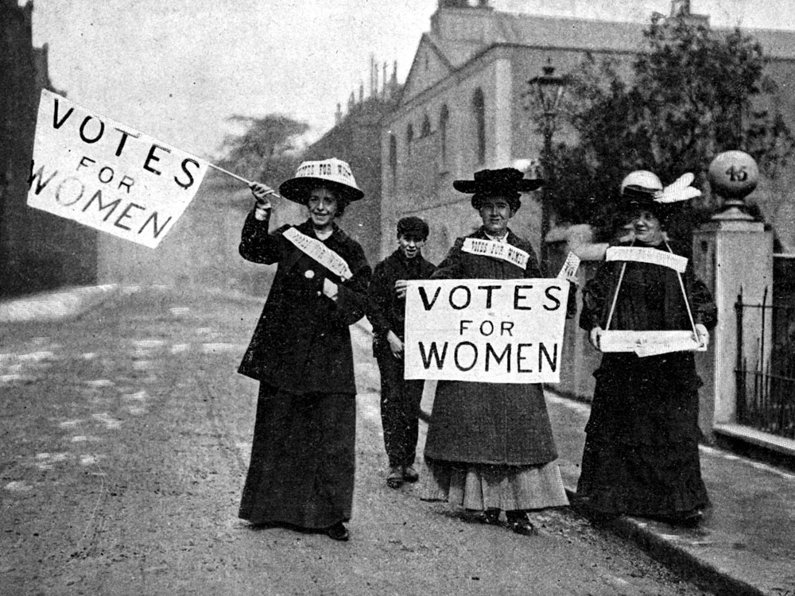
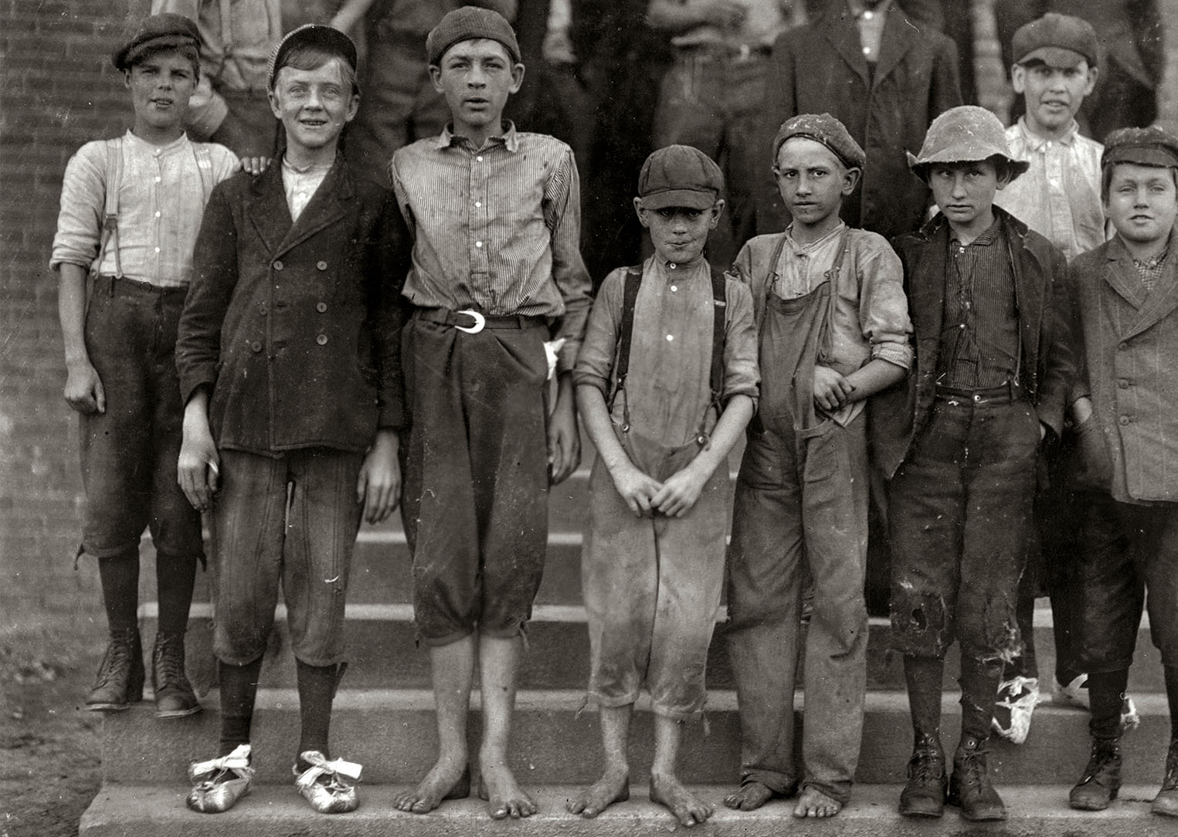
Reading
How can an author help us to really capture the spirit of Victorian times?
Non Fiction, DK Eyewitness Victorians
Narrative, Street Child by Berlie Doherty
English Enquiry
What would it have felt like to be a child in Victorian England? Recount and narrative writing
PE
Swimming
Outdoor Adventures
Maths
Statistics
Measurement: length, height, perimeter, time
Fractions
PSHE/ Growing and Glowing
What is fair?
Is fairness important?
Who is in charge and why?
Artistic Enquiry
How does an artist bring beauty to the common man?
Who was William Morris and what techniques did he use as an artist?
Create a clay tile
Class 2 - Spring 2 - 2019
Who really holds the power?
Our Value is Justice
Historic Enquiry
How did Victorian England shape our society and begin to promote equality? An exploration into child, and class equality.
ICT
Word processing
Scientific enquiry
What scientific forces are at play in our world?
Pushing and pulling investigations
Magnetic investigations
RE
What can you learn from the Christian Saints and the Easter Story?
Musical Enquiry
What kinds of music Victorians would have had?

