Slide 1
Welcome to Class 1
Miss Hodgson

Slide 2
Our Team
Class Teacher:
Miss Hodgson
Teaching Assistants:
Mrs Gabriel, Miss Smith, Miss Binney

Slide 3
Our Philosophy
We want children to feel safe and happy in our environment. We want them to feel nurtured and listened to. We want children to love coming to school and to be excited about the learning opportunities that await them.
We strongly believe in the power of play. It builds social confidence, independence and opportunity to make connections between learning.
“Play is the highest form of research.” Albert Einstein
We want to support children to become confident, curious learners not bound by the constrains of adult schemas or their predecessor. We want them to be open minded to new ways of doing things. We cannot just prepare them for our world as it is adapting so rapidly. Things have changed so quickly in the last 30 years that we cannot predict what it will be like in another 30. We need children to be confident that they can take on the challenges that we don’t even know about yet.

Slide 4
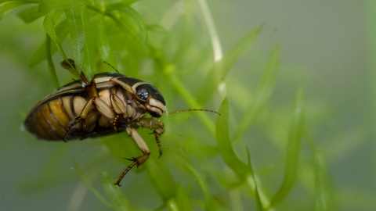
Learning Culture
Catching Mistakes / Marvellous Mistakes
Being in ‘the pit’
Diving Beetles V Pond Skaters
Flat Earthers
The Learning Spark

Slide 5
Typical Weekly Timetable

Slide 6
Coordinating Two Curriculums
Early Years Foundation Stage | Year 1 National Curriculum
Personal, Social and Emotional | PSHE
Physical Development | PE
 | SRE (sex, relationships and education)
Communication and Language | English
Literacy
Mathematics | Mathematics
Expressive Art and Design | Music
 | Art
 | Design Technology
Understanding the World | Geography
 | History
 | RE
 | Computing
 | Science
 | French

Slide 7
School Uniform
Correct school uniform
-royal blue sweatshirt
-grey or black trousers/shorts or skirts,
-white polo shirt
(In the summer there is the option of blue and white checked dresses .)
Suitable PE kit
-sky blue t-shirt
-plain black shorts
-plain black jogging bottoms (for cold weather sports outdoors)
-plain black sweatshirt (for cold weather sports outdoors)
-pair of comfortable sports trainers which can be tightly fastened and support their ankles
All weather coat
Book bag
Water bottle
Full stomach
Plenty of sleep

Slide 8
Topic Webs
Topic Webs are produced each half term to inform you, and your child, about our learning adventure.

Slide 9
Imagine You Had To Grow A Brain…
Notes:
Explain that ‘growing brains’ is actually our core business but parents have a greater role in this as they are their child’s primary educators.
Why is there a huge focus on it in our next stage of school improvement?
Explain that we still see children who have low self confidence and don’t believe they can learn well. They cannot cope with failure and some are very passive – they give up and cannot work independently.
Staff understand that children need to understand that making mistakes is part of learning, it is ok to fail, and that every brain has the capacity to grow new connections and learn over time.

Slide 10
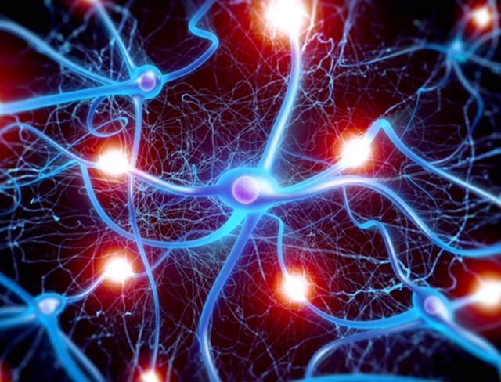
We are all growing new connections in your children’s brains every moment of every day.
Notes:
Going into detail – every time a child practices something new, a connection is made in the brain. These connections strengthen with repeated practice. The more memorable the learning experience, the stronger the connections.

Slide 11
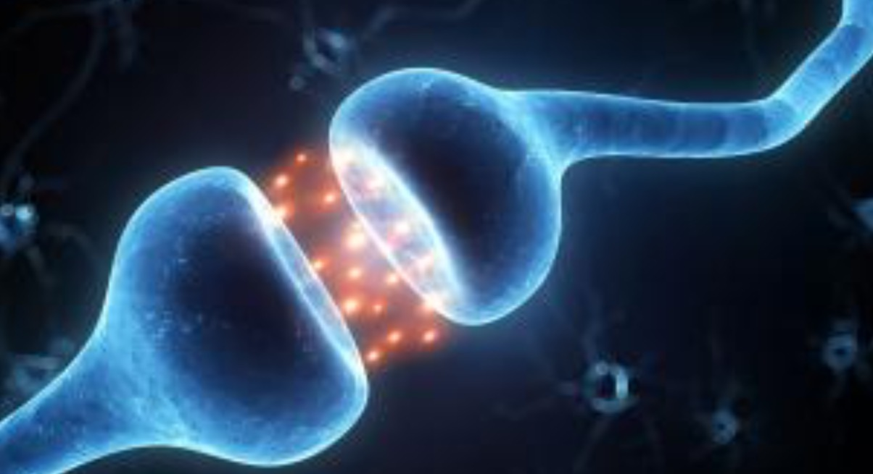
We are literally sculpting brains.
Notes:
This is as much emotionally as academically! The repeated firing off of synapses creates brain growth. Learning new things is a struggle – it should be hard - and a child’s resilience and self belief in the face of challenge is all about their mindset. This includes learning to manage their own behaviour…

Slide 12
Mindsets:
Fixed mindset:
Belief that ability is fixed
People are born smart/sporty, etc.
Depressed after failure
Puts in less effort
Doesn’t try new strategies
Growth mindset:
Belief that people can grow and develop
Sees failure/setback as a learning opportunity
Puts in effort and persists
Tries alternative routes to success
Notes:
Just talk through the different mindsets and ask parents to consider which category they/their children might fall into. Most people are a mixture of both, but a child who has a fixed mindset has a limited potential to make progress. For this reason, as part of our learning each day, we will be talking about growth mindset and our learning toolkit.

Slide 13
What will Growth mindset look like in your Child’s Classroom?
There will be a significant shift in how we mark and give feedback
There will be a huge focus on looking at examples of excellence and drawing out the components or Success criteria
Children will be encouraged to seek out challenge and embrace mistakes
There will be regular, direct teaching of growth mindset.
Notes:
These are the key elements of our practice in school. It encourages children to develop and use their growth mindset. We are trying to remove all the barriers to each child’s learning potential

Slide 14
Our mindset curriculum is designed to develop:
resilience
a desire to be challenged
high quality talk and collaborative learning within the classroom
independent learners who understand their accountabilities
strategies to success so that everyone is enabled
Notes:
If you would like to know more and find out how you can help at home, there will be a much more detailed exploration of this if you are able to come to a talk by Mrs Cox during the Book Snuggle (date in newsletter).

Slide 15
Assemblies
Monday: leadership assembly with Mrs Kirkman
Tuesday: ‘Open the Book’ assembly focusing on stories from the Bible.
Wednesday: leadership assembly with Mrs Cox
Thursday: singing assembly with Mrs Smith
Friday: Tribe assembly with class teachers
These may change based on other influences and constrains on the week but we try to keep them as regular as possible.

Slide 16
Homework
Early Years Foundation Stage | Year 1 National Curriculum
Home learning challenges sent out each half term where evidence can be uploaded to Tapestry. | Fortnightly homework send out with a formal hand in date. Homework begins this week.

Slide 17
Reading
Children will have a range of opportunities in class to support their reading:​
Guided Reading lessons
Library Sessions
Class story time
Time to read independently to an adult​
Shared reading in Phonics
Reading opportunities in Literacy
Reading at home is vital. The books that go home are an opportunity to practise the skills for reading taught in school. We try to hear children as often as possible but we physically cannot get to everyone as often as we might like. Please record your reading at home so we can see the amount of practise put in and decide when new books are needed.
Look out for Phonic workshops, reading workshops and book snuggles coming up soon.

Slide 18
Year 1 Phonic Assessment
This assessment will assess children’s grapheme-phoneme correspondence alongside their ability to blend.
They are presented with a range of words both ‘real’ and ‘alien’ words that the children should be able to read accurately.
Children do have the opportunity to repeat this in Year 2 but if they can pass it in Year 1 their reading will be in a better place for the raised expectation again in Year 2.
The assessment includes trigraphs, split-digraphs, alternative sounds and can include unusual combinations of sounds.
Our advice is to rehearse these skills but to also focus on reading for meaning in texts, to enjoy story times and to focus on your own child’s specific next step in their development.

Slide 19
E-safety
Regular lessons - importance of E-Safety, how to stay safe online​
School Filters are provided by SWGfL​
Children are taught to tell an adult if anything pops up they didn’t want such as error boxes or website links.
Children are taught never to share passwords or personal information about themselves.
Participation in Safer Internet events and whole school assemblies addressing the issue​.
Regular staff updates to keep all staff informed of the most recent developments​.
Yearly reviews of School Internet Safety Policy conducted by school leadership and governors​.

Slide 20
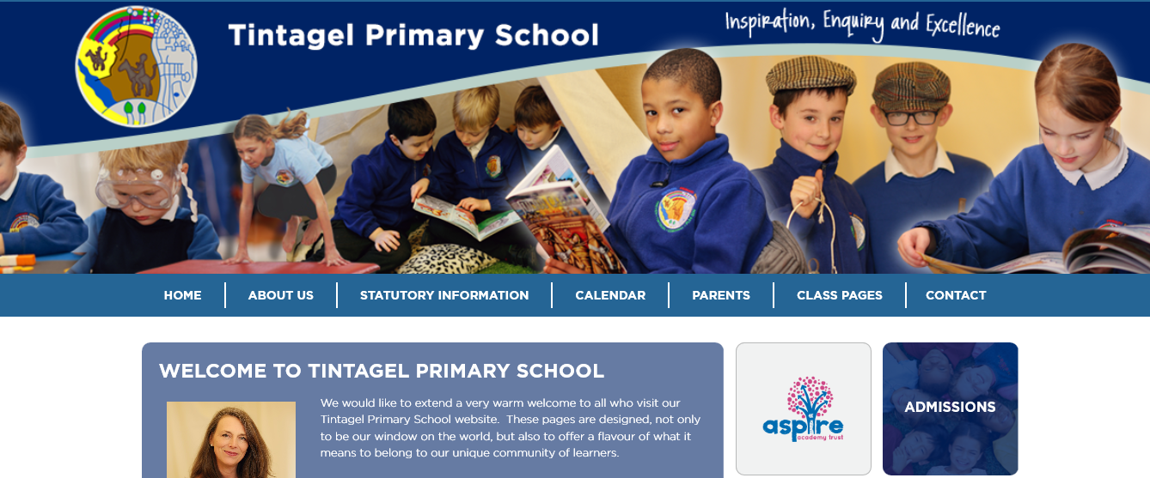
School Website
Early Years Page (About Us > Early Years)
Class Page (Class Pages > Class 1)

Slide 21
The Magic Triangle
The Child
Environment
(Tertiary Educators)
Parents/Carers
(Primary Educators)
School
(Secondary Educators)

