Slide 1
Welcome (back) to Class 3…

Slide 2
The regulars…
Miss Court
Mrs Reynolds
Mrs Ubly
Miss Smith
Mrs Cox
Our core business…

Slide 3
Please make sure that.
Correct uniform
Suitable, plain and appropriate PE kit in school to take part in daily exercise activities.
An all weather coat
Book bag
Plenty of sleep and a full stomach

Slide 4
A Typical Day
9:00 Register/Timetable/Interventions
9:10 Assembly/Handwriting/Times Tables
9:30 – 12:00 (15min break) Core Subjects – English and Maths
13:00 – 15:00 Foundation Subjects – the rest

Slide 5
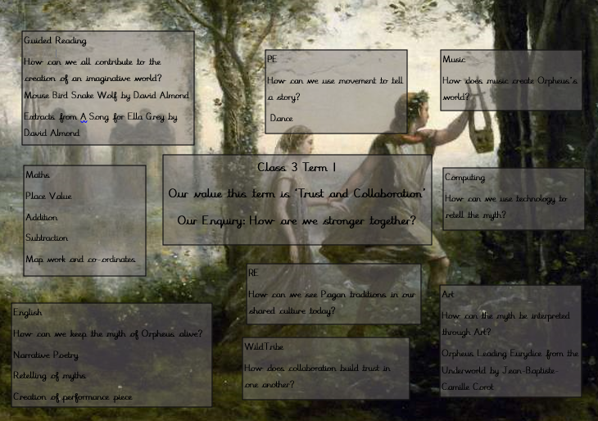

Slide 6
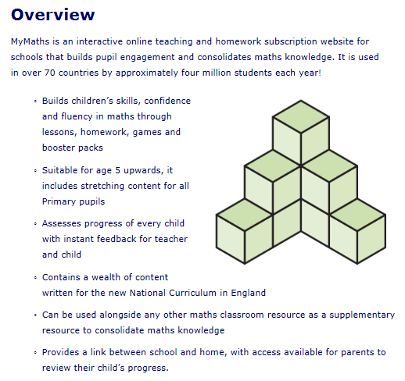
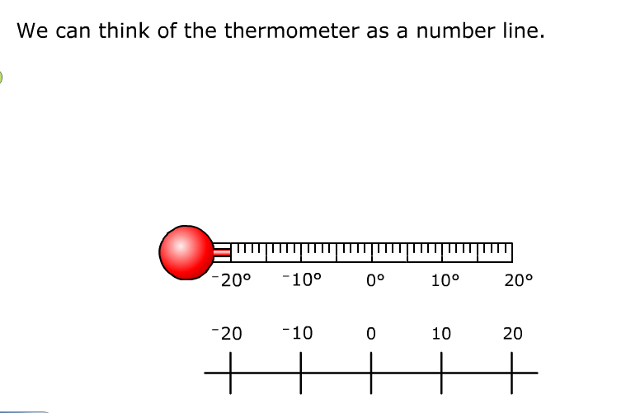
My Maths
My Maths is an online programme school subscribes to which is used as a teaching tool for some maths lessons, can be used independently by pupils within lessons and can also be used to set homework tasks.
You should have all now received your username and password and tasks will be set over the next few weeks.
There is no need to print off results as these can be accessed digitally by the class teacher.

Slide 7
Reading
Children will have a range of opportunities in class to support their reading:
Guided Reading lessons with individuals, groups and to the whole class
Time to read independently
Being heard and supported individually by adults,
Reading aloud to the rest of class.
A reading record will be given to all children.
Reading at home at least four times a week
We will be having a Reading Workshop /Snuggle on Tuesday 25th September.

Slide 8
Our Values and Enquiries For This Year
Aut 1: Trust and Collaboration – How are we stronger together?
Aut 2: Perseverance – What matters the most, the journey or the destination?
Spr 1: Honesty - Are there two sides to every story?
Spr 2: Justice – Who really holds the power?
Sum 1: Kindness – How does kindness shape the f future for all of us?
Sum 2: Wisdom – How have we learnt from the past?

Slide 9
Opportunities
Field Trips
Swimming – Spring Term
Immersion Days

Slide 10
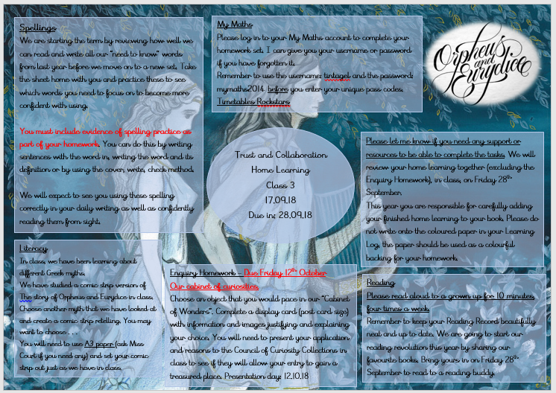
Homework
Set and received every two weeks with shared feedback – consolidating taught skills, building and raising standards and pride. Time will be given for children at school.

Slide 11
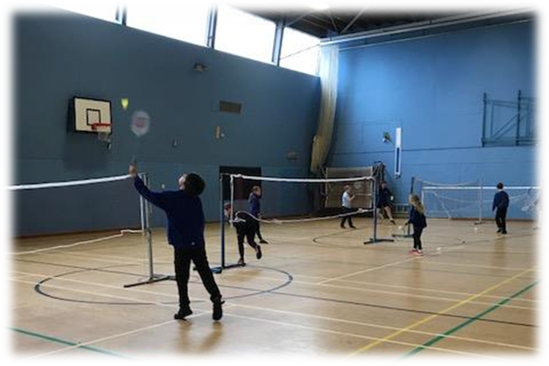

Slide 12
Our PE lessons are very active. For safety reasons, we cannot allow children to participate in PE lessons unless they are wearing appropriate clothing.
If for any reason, you cannot bring in school PE kit. Please temporarily provide a suitable alternative so your child can still join in their lesson.

Slide 13
September 2018 onwards
To show we are a united Tintagel Tribe we would like every child to wear our school colour – Sky blue.
Please wear a Sky blue PE-t-shirt

Slide 14
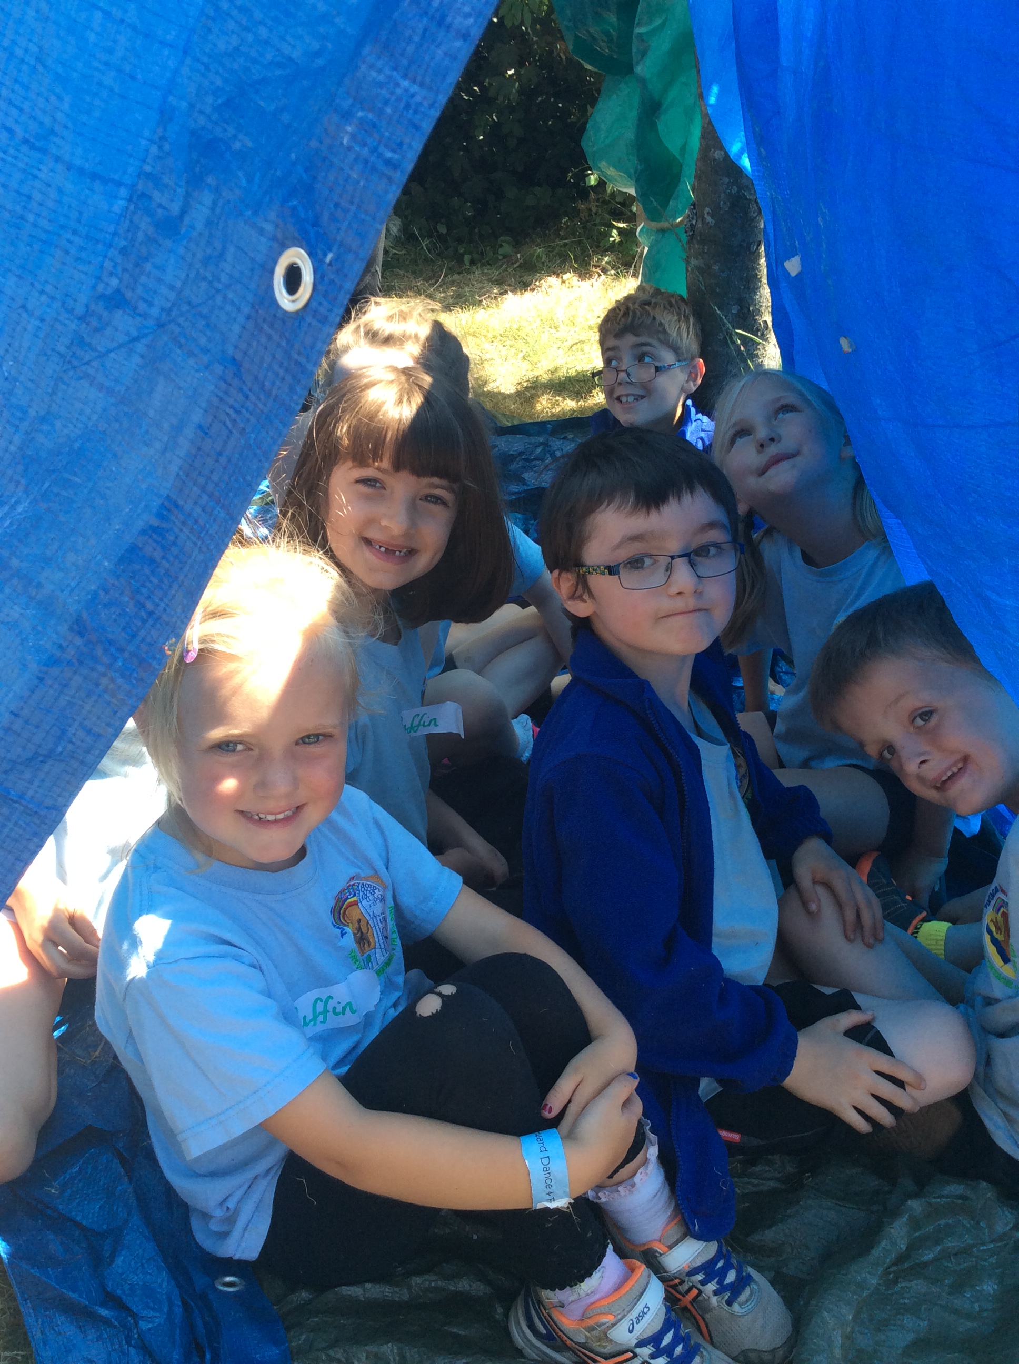
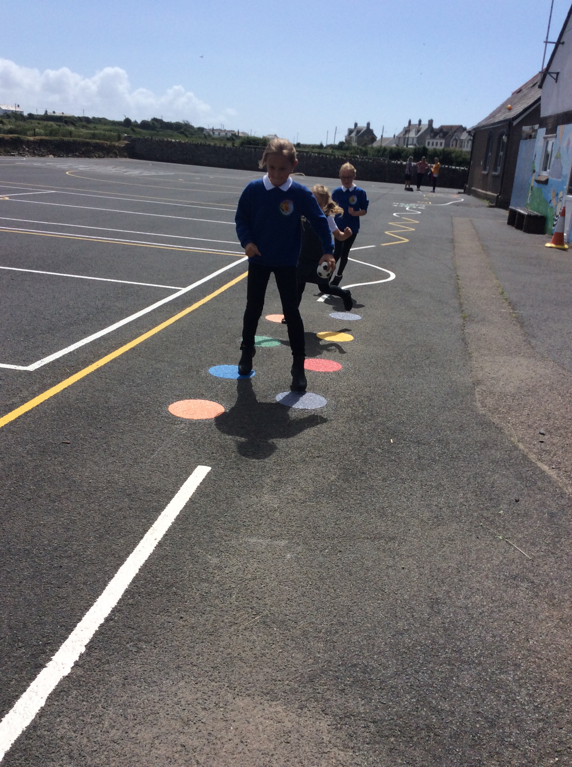
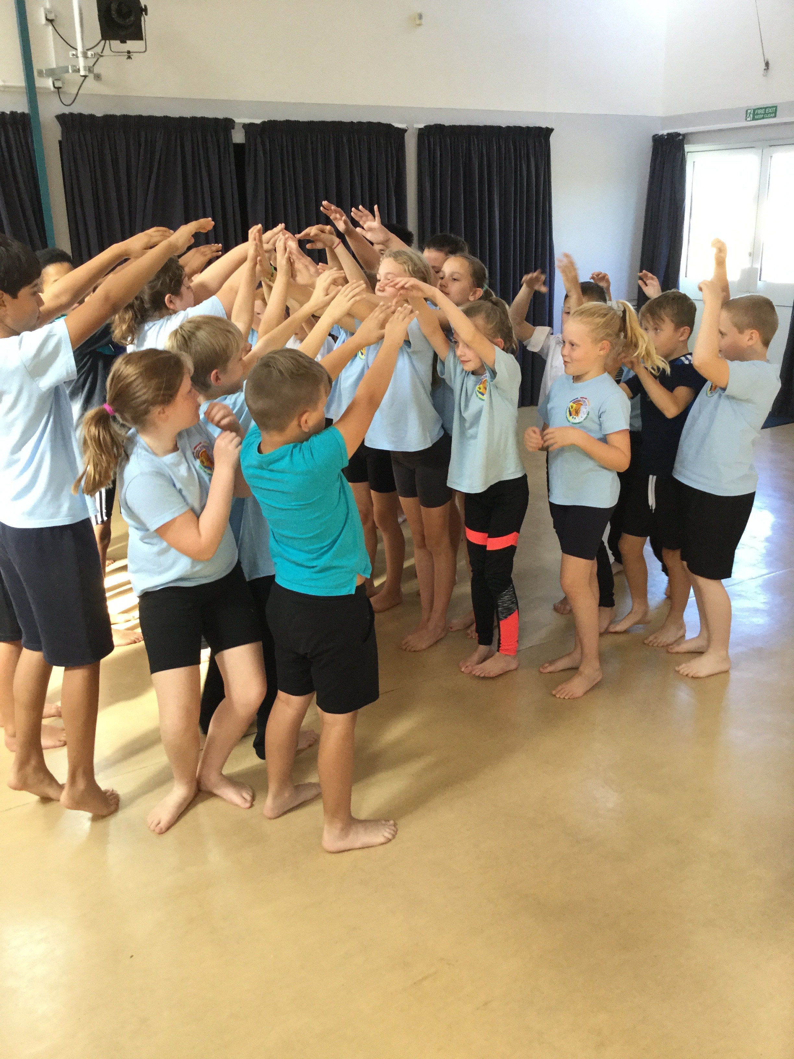
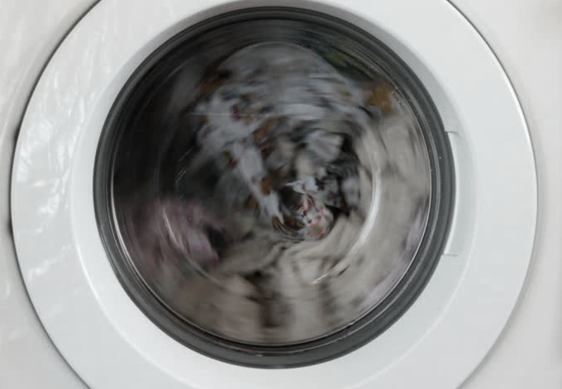
We are a very active school and PE kit need to be in school at all times.
PE kits may be needed for other activities such as active maths, forest school, using the bike trail, drama, gardening etc.
If kit is dirty please take home at the weekend and return it by the Monday.

Slide 15
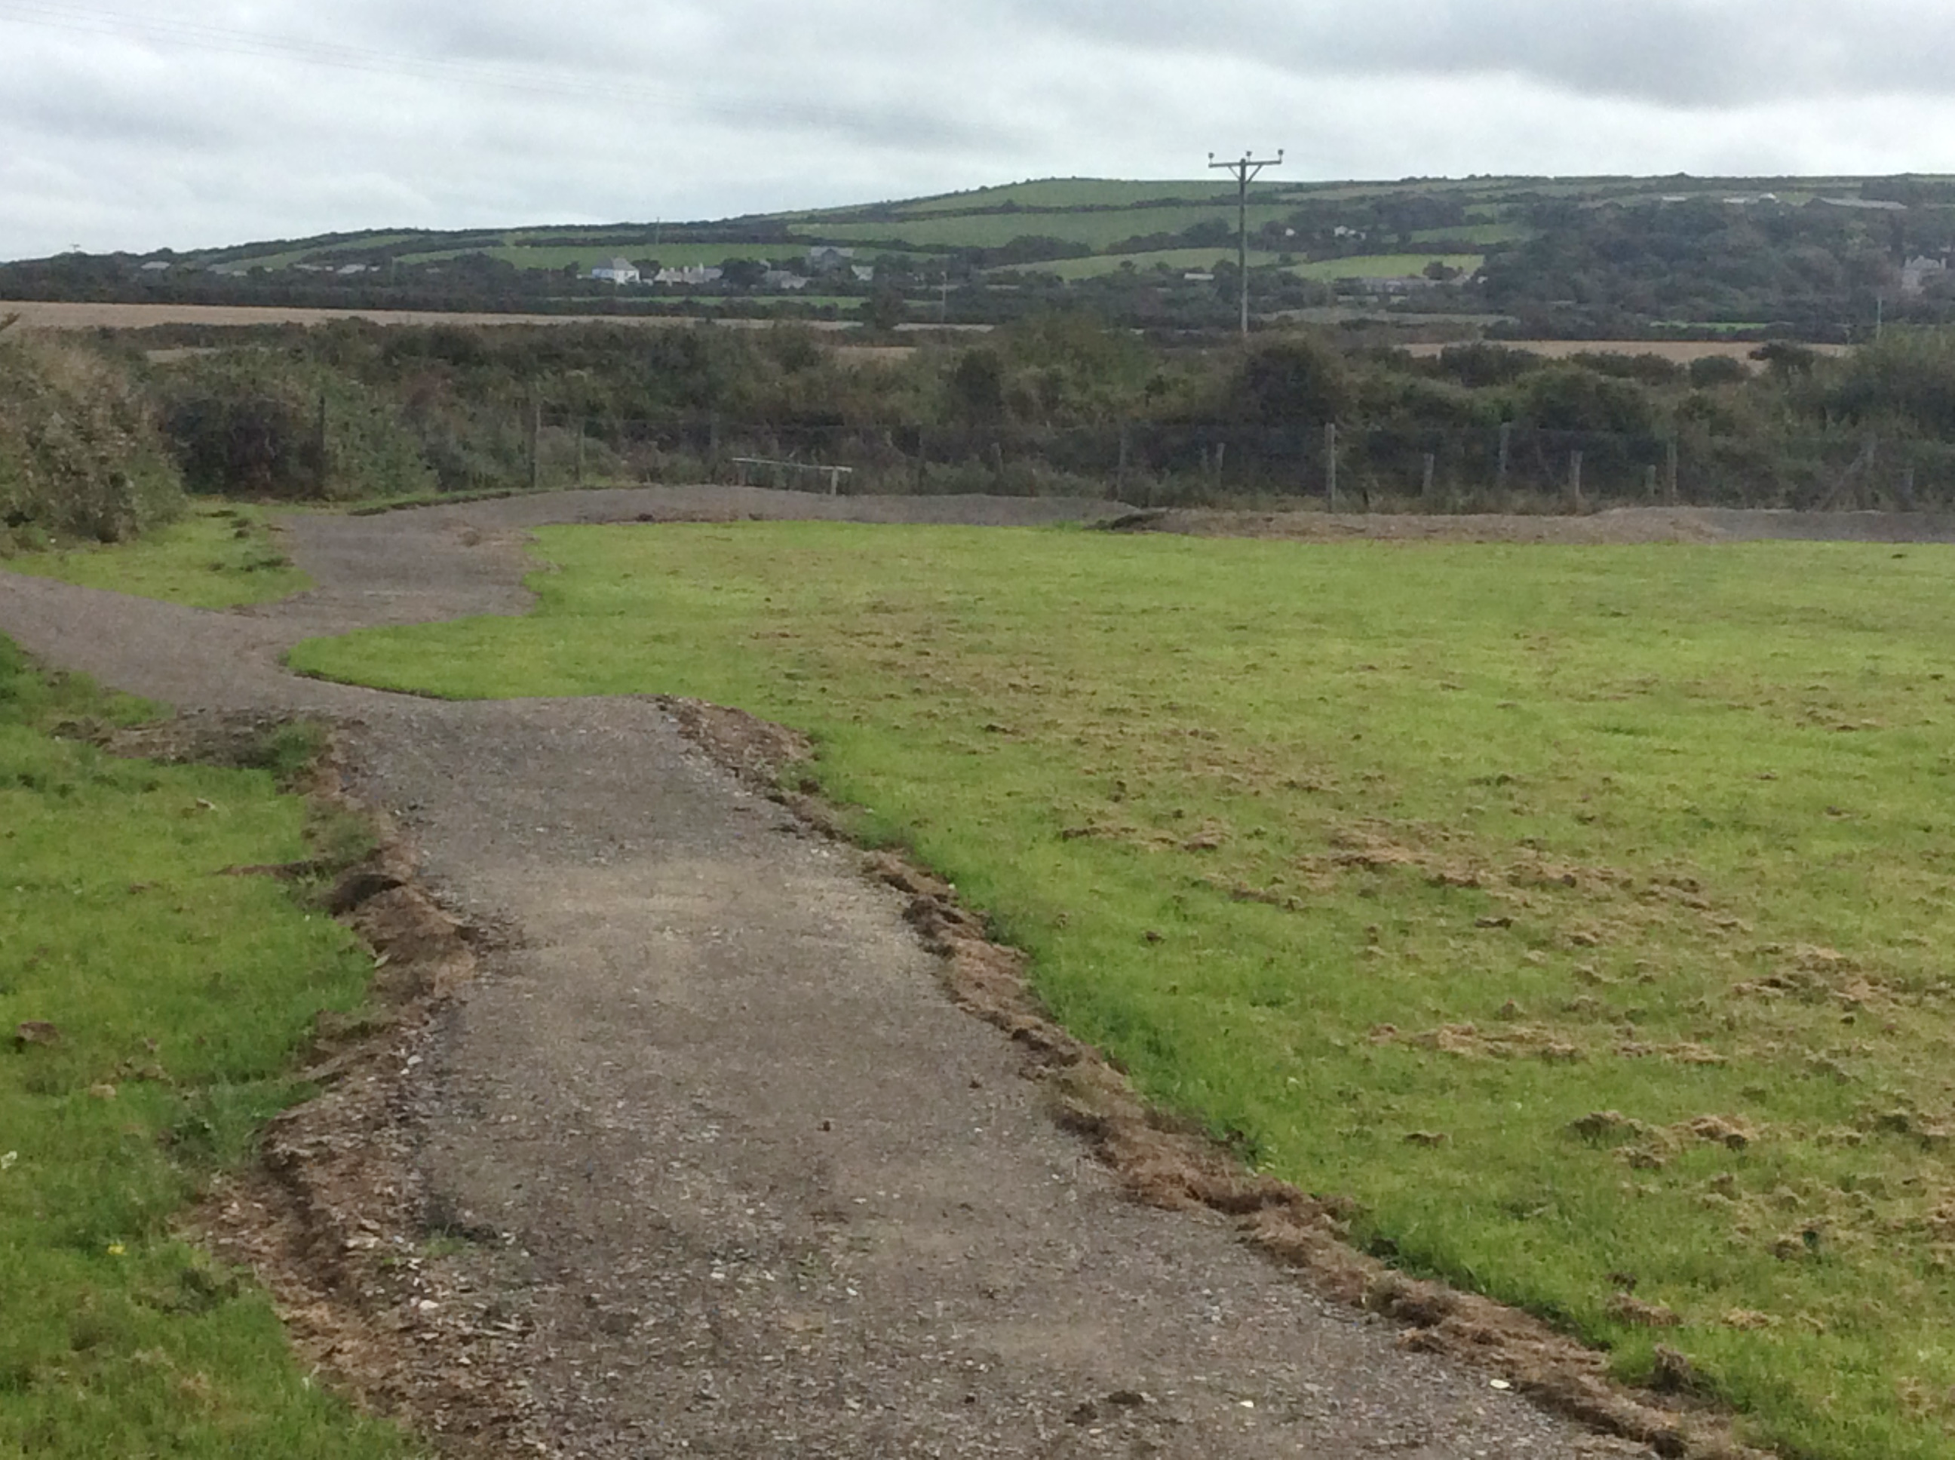
New Bike Trail
In the near future the school will purchase a few bikes to use on our trail.
In the meantime, a class letter will be sent home to inform you when your child is able to bring in their own bikes.

Slide 16
E Safety
Regular lessons - importance of E-Safety, how to stay safe online
Filters that are provided by SWGfL
Tell an adult if they see anything inappropriate
Children told never to share passwords and the danger of sharing personal information online
Participation in Safer Internet events and whole school assemblies addressing the issue
Regular staff updates to keep all staff informed of the most recent developments
Yearly reviews of School Internet Safety Policy conducted by school leadership and governors

Slide 17
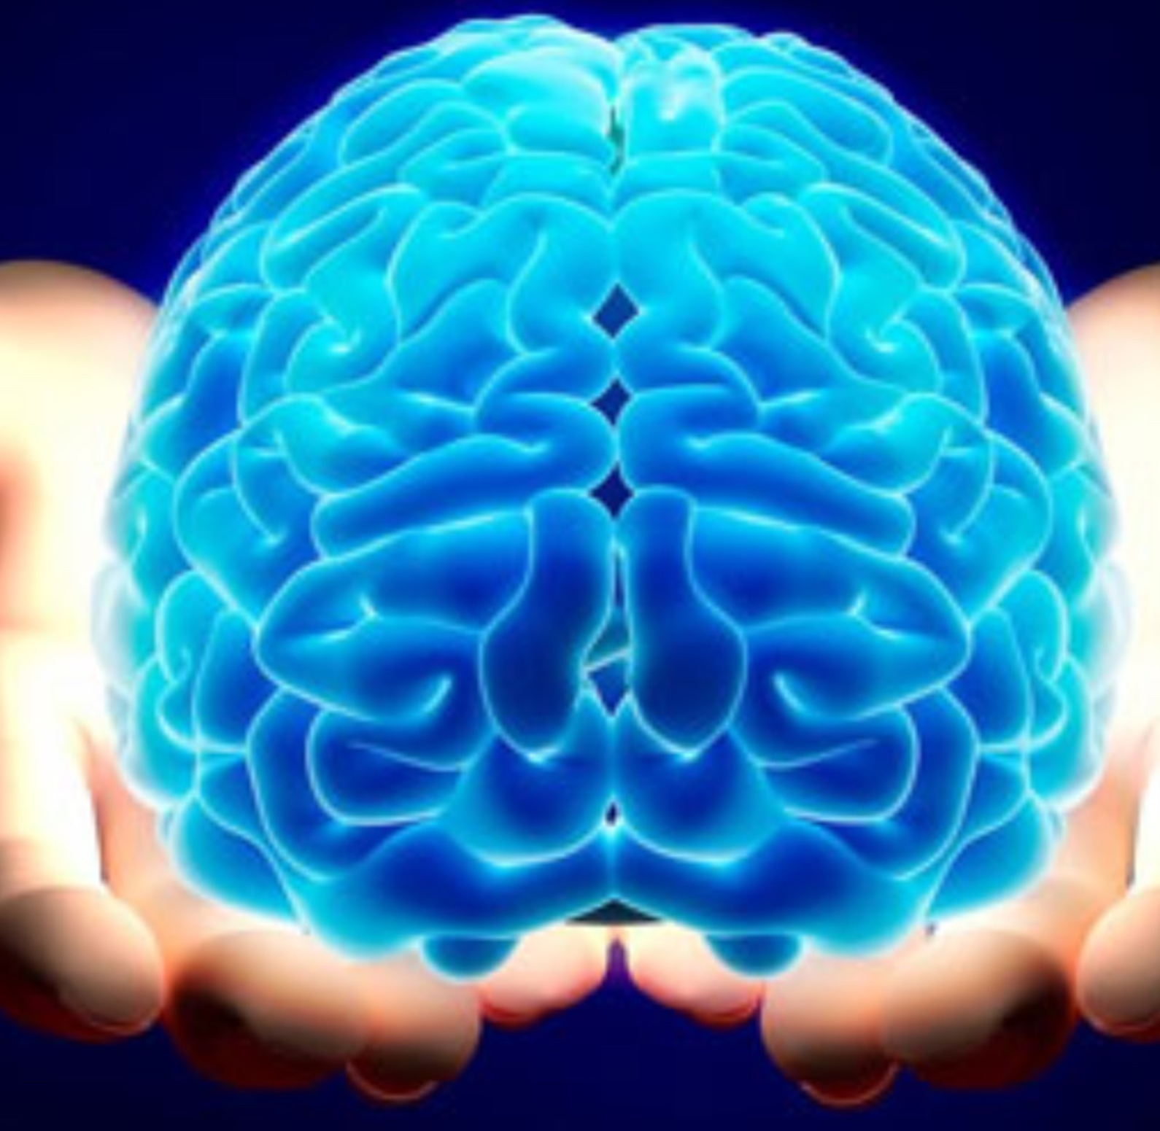
Imagine You Had To Grow A Brain…
Notes:
Explain that ‘growing brains’ is actually our core business but parents have a greater role in this as they are their child’s primary educators.
Why is there a huge focus on it in our next stage of school improvement?
Explain that we still see children who have low self confidence and don’t believe they can learn well. They cannot cope with failure and some are very passive – they give up and cannot work independently.
Staff understand that children need to understand that making mistakes is part of learning, it is ok to fail, and that every brain has the capacity to grow new connections and learn over time.

Slide 18
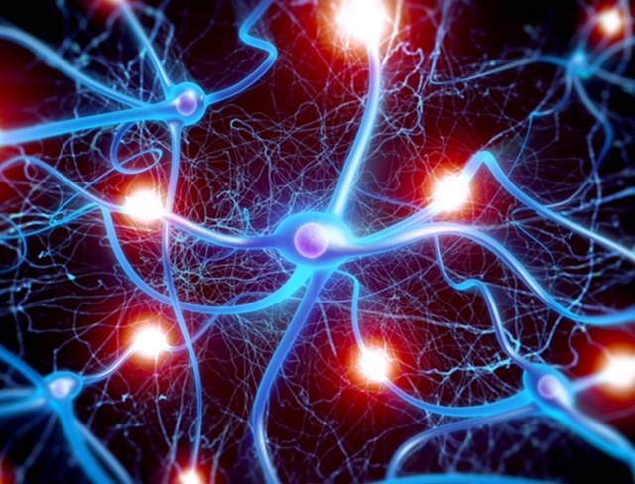
We are all growing new connections in your children’s brains every moment of every day.
Notes:
Going into detail – every time a child practices something new, a connection is made in the brain. These connections strengthen with repeated practice. The more memorable the learning experience, the stronger the connections.

Slide 19
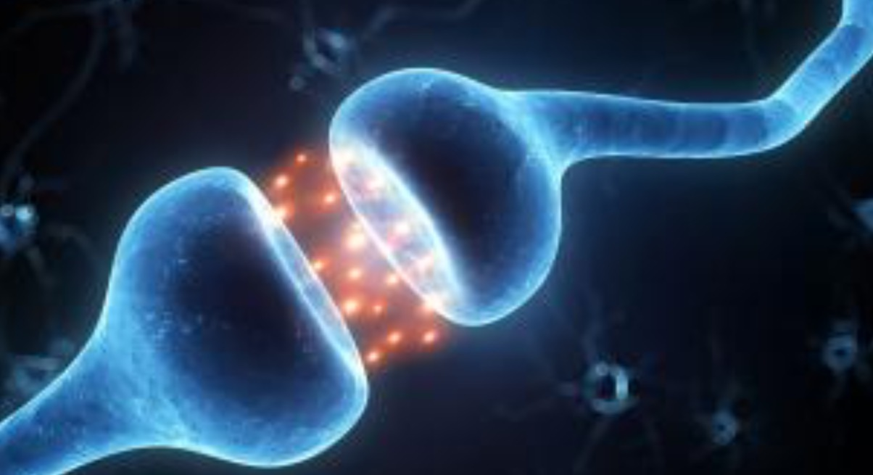
We are literally sculpting brains.
Notes:
This is as much emotionally as academically! The repeated firing off of synapses creates brain growth. Learning new things is a struggle – it should be hard - and a child’s resilience and self belief in the face of challenge is all about their mindset. This includes learning to manage their own behaviour…

Slide 20
Mindsets:
Fixed mindset:
Belief that ability is fixed
People are born smart/sporty, etc.
Depressed after failure
Puts in less effort
Doesn’t try new strategies
Growth mindset:
Belief that people can grow and develop
Sees failure/setback as a learning opportunity
Puts in effort and persists
Tries alternative routes to success
Notes:
Just talk through the different mindsets and ask parents to consider which category they/their children might fall into. Most people are a mixture of both, but a child who has a fixed mindset has a limited potential to make progress. For this reason, as part of our learning each day, we will be talking about growth mindset and our learning toolkit.

Slide 21
What will Growth mindset look like in your Child’s Classroom?
There will be a significant shift in how we mark and give feedback
There will be a huge focus on looking at examples of excellence and drawing out the components or Success criteria
Children will be encouraged to seek out challenge and embrace mistakes
There will be regular, direct teaching of growth mindset.
Notes:
These are the key elements of our practice in school. It encourages children to develop and use their growth mindset. We are trying to remove all the barriers to each child’s learning potential

Slide 22
Our mindset curriculum is designed to develop:
resilience
a desire to be challenged
high quality talk and collaborative learning within the classroom
independent learners who understand their accountabilities
strategies to success so that everyone is enabled
Notes:
If you would like to know more and find out how you can help at home, there will be a much more detailed exploration of this if you are able to come to a talk by Mrs Cox during the Book Snuggle (date in newsletter).

Slide 23
Any ideas
Please let us know if you have any suggestions

