Slide 1
Welcome (back) to Class 4…

Slide 2
The regulars…
Mrs Kirkman,
Mr Doman
Miss Court
Mrs Ubly
Mrs Cox
Mrs Smith
Our core business…

Slide 3
Please make sure that.
Correct uniform
Suitable, plain and appropriate PE kit in school to take part in daily exercise activities. – Usually Monday and Friday
An all weather coat
Book bag/School bag
Plenty of sleep and a full stomach

Slide 4
A Typical Day
8:55 Register/Handwriting/Times Tables
9:15 Daily Assembly
9:30 – 12:00 (15min break) Core Subjects – English and Maths, Science
13:00 – 15:15 Foundation Subjects – the rest

Slide 5
CLASS 4
Term 1: Our Value is TRUST AND COLLABORATION
READING
Reading into Writing
How do we listen to a writer’s voices to improve our technique?
Beowulf – A Quest Story
MUSIC
How can we feel nature through the use of percussion and orchestration?
Using percussion instruments to create soundscapes to bring a setting to life
ENGLISH
How do Myths capture the essence of humanity: nature, destiny, balance, togetherness, memory and mortality?
Descriptions
Narrative
Script Writing
Retelling the Myth
MATHS
Arithmetic & Place Value
Working with numbers up to 10,000,000
Ordering digits
Rounding numbers
+ - x ÷
P.S.H.E.
Why do we share the same aspirations?
Dreams and Goals
GEOGRAPHY
How can we transfer our skills to transpose The Underworld?
Mapping and Field Work
How Are We Stronger Together?
PE
How can we build our fitness and performance as a community?
Dance/Gymnastics
Fitness
SCIENCE
How can we build, test, improve and apply our circuits together?
Electricity
RE
What are the different parts of the bible?
Investigating how the bible is structured and laid out
Art
Working with different materials – Metal work with nature

Slide 6
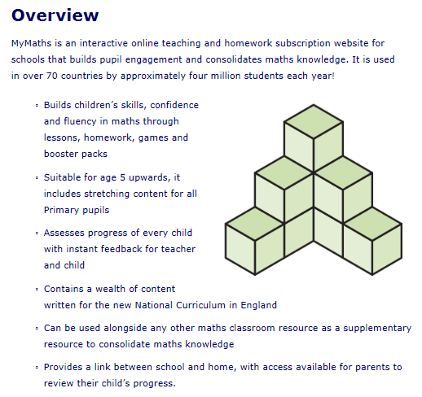
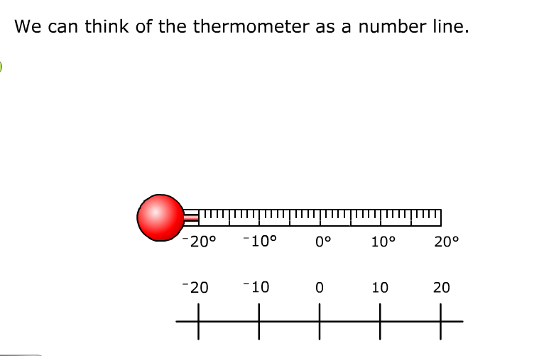
My Maths
My Maths is an online programme school subscribes to which is used as a teaching tool for some maths lessons, can be used independently by pupils within lessons and can also be used to set homework tasks.
You should have all now received your username and password and tasks will be set over the next few weeks.
There is no need to print off results as these can be accessed digitally by the class teacher.

Slide 7
Reading
Children will have a range of opportunities in class to support their reading:
Guided Reading lessons with individuals, groups and to the whole class.
Time to read independently.
Being heard and supported individually by adults.
Reading aloud to the rest of class.
A reading record will be given to all children.
Reading at home at least four times a week.
We will be having a Reading Workshop /Snuggle on the 25th September.

Slide 8
Looking forward to in 2018/19 as part of the Enquiry Curriculum…
Orpheus and Eurydice - How are we stronger together -
Ice and Fire- - How our planet shapes itself ?
The Wall - Who holds the power?
The Voyage of the Beagle – Why are there two sides to every story?
Kindness - How does kindness shape the future for all of us?
Wisdom - How do we learn from the past

Slide 9
Our Values For This Year
Aut 1 Trust
Aut 2: Perseverance
Spr 1: Honesty
Spr 2: Justice
Sum 1: Kindness
Sum 2: Wisdom

Slide 10
Opportunities
Field Trips, Surfing, Eden,
Residentials x 2 - Summer Term, TBC, London
Class 4 Assembly - TBC
Swimming - February
Performances

Slide 11
A Classroom of Marvellous Mistakes

Slide 12
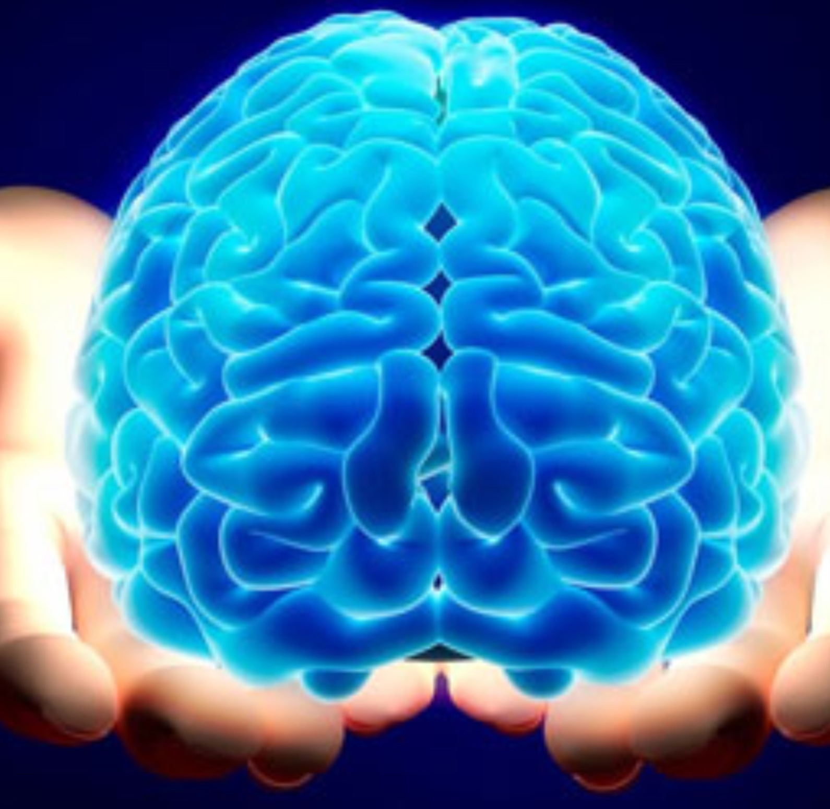
Imagine You Had To Grow A Brain…
Notes:
Explain that ‘growing brains’ is actually our core business but parents have a greater role in this as they are their child’s primary educators.
Why is there a huge focus on it in our next stage of school improvement?
Explain that we still see children who have low self confidence and don’t believe they can learn well. They cannot cope with failure and some are very passive – they give up and cannot work independently.
Staff understand that children need to understand that making mistakes is part of learning, it is ok to fail, and that every brain has the capacity to grow new connections and learn over time.

Slide 13
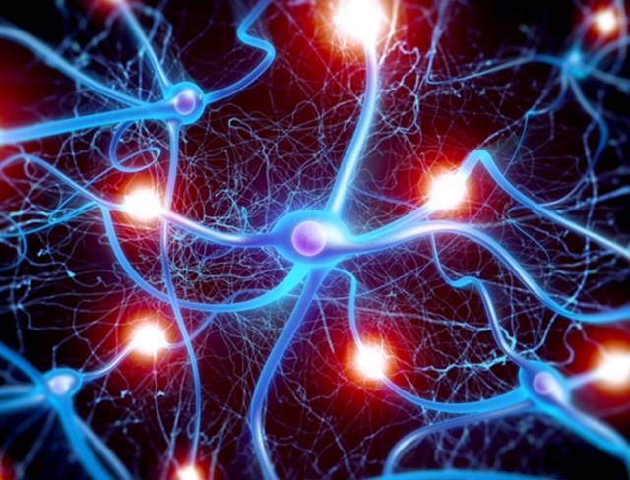
We are all growing new connections in your children’s brains every moment of every day.
Notes:
Going into detail – every time a child practices something new, a connection is made in the brain. These connections strengthen with repeated practice. The more memorable the learning experience, the stronger the connections.

Slide 14
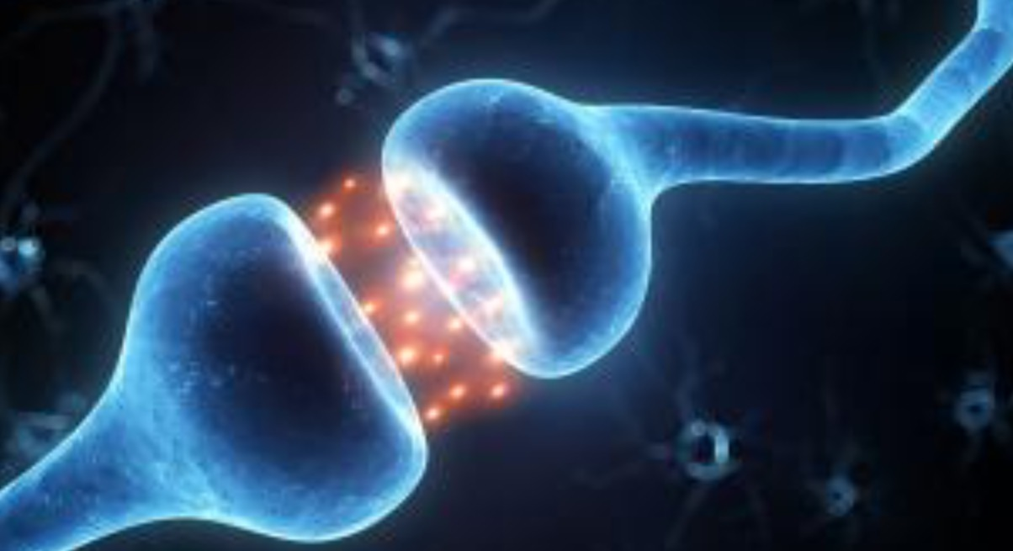
We are literally sculpting brains.
Notes:
This is as much emotionally as academically! The repeated firing off of synapses creates brain growth. Learning new things is a struggle – it should be hard - and a child’s resilience and self belief in the face of challenge is all about their mindset. This includes learning to manage their own behaviour…

Slide 15
Mindsets:
Fixed mindset:
Belief that ability is fixed
People are born smart/sporty, etc.
Depressed after failure
Puts in less effort
Doesn’t try new strategies
Growth mindset:
Belief that people can grow and develop
Sees failure/setback as a learning opportunity
Puts in effort and persists
Tries alternative routes to success
Notes:
Just talk through the different mindsets and ask parents to consider which category they/their children might fall into. Most people are a mixture of both, but a child who has a fixed mindset has a limited potential to make progress. For this reason, as part of our learning each day, we will be talking about growth mindset and our learning toolkit.

Slide 16
What will Growth mindset look like in your Child’s Classroom?
There will be a significant shift in how we mark and give feedback
There will be a huge focus on looking at examples of excellence and drawing out the components or Success criteria
Children will be encouraged to seek out challenge and embrace mistakes
There will be regular, direct teaching of growth mindset.
Notes:
These are the key elements of our practice in school. It encourages children to develop and use their growth mindset. We are trying to remove all the barriers to each child’s learning potential

Slide 17
Our mindset curriculum is designed to develop:
resilience
a desire to be challenged
high quality talk and collaborative learning within the classroom
independent learners who understand their accountabilities
strategies to success so that everyone is enabled
Notes:
If you would like to know more and find out how you can help at home, there will be a much more detailed exploration of this if you are able to come to a talk by Mrs Cox during the Book Snuggle (date in newsletter).

Slide 18
SATs
Maths, Reading, SPaG
Monday 13th – Thursday 16th May 2019
Writing
A variety of Booster Clubs will be offered for the Year 6 children closer to the time and children will be given a set of revision books.

Slide 19
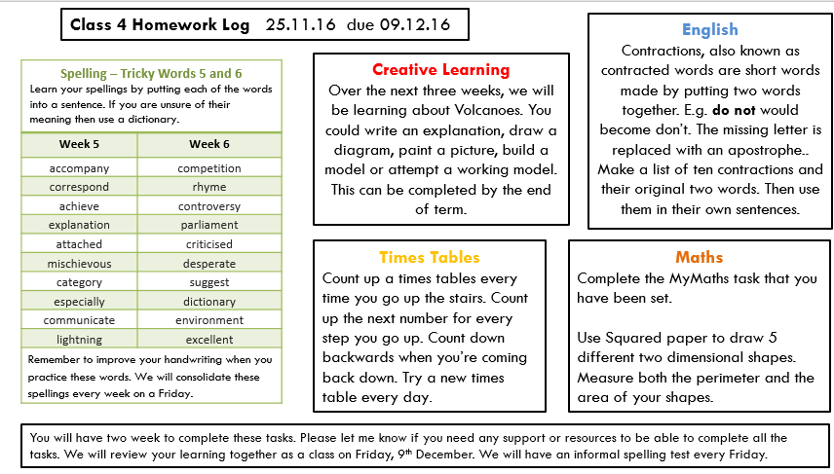
Homework - Starting this week
Set and received every two weeks with shared feedback – consolidating taught skills, building and raising standards and pride. Time will be given for children at school.

Slide 20
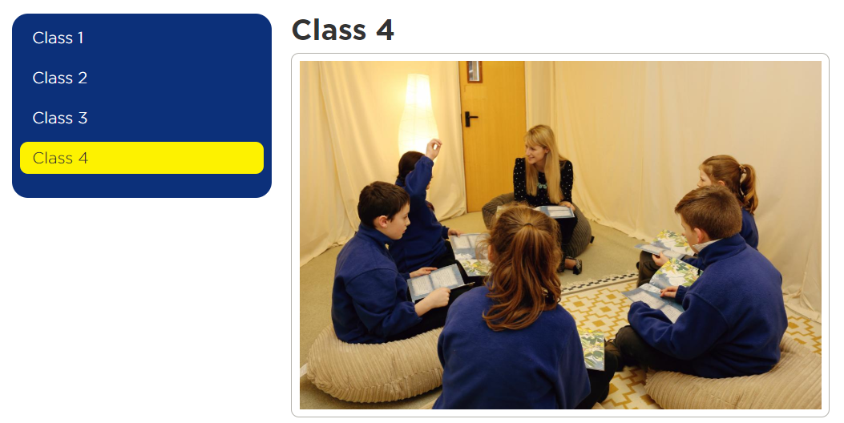
The Website…

Slide 21
E Safety
Regular lessons - importance of E-Safety, how to stay safe online
Filters that are provided by SWGfL
Tell an adult if they see anything inappropriate
Children told never to share passwords and the danger of sharing personal information online
Participation in Safer Internet events and whole school assemblies addressing the issue
Regular staff updates to keep all staff informed of the most recent developments
Yearly reviews of School Internet Safety Policy conducted by school leadership and governors

